Slide 1




Deep Learning-Based PET Image Correction Toward Quantitative Imaging
Presenter: Sama Shahpouri
Study : Data Science for Life Science
Institute: Hanze University of Applied Sciences, Institute of Life Science & Technology
Supervisors: Dr. Isaac Shiri, Dr. Dave Landers, Dr. Gijs van der Schot
28/08/2024

Slide 2
Introduction of PET & ASC Problem Statement Research Objective Data Collection Methodology Internal Validation Results External Validation Results Artifact Correction Results Conclusion
Agenda

Slide 3
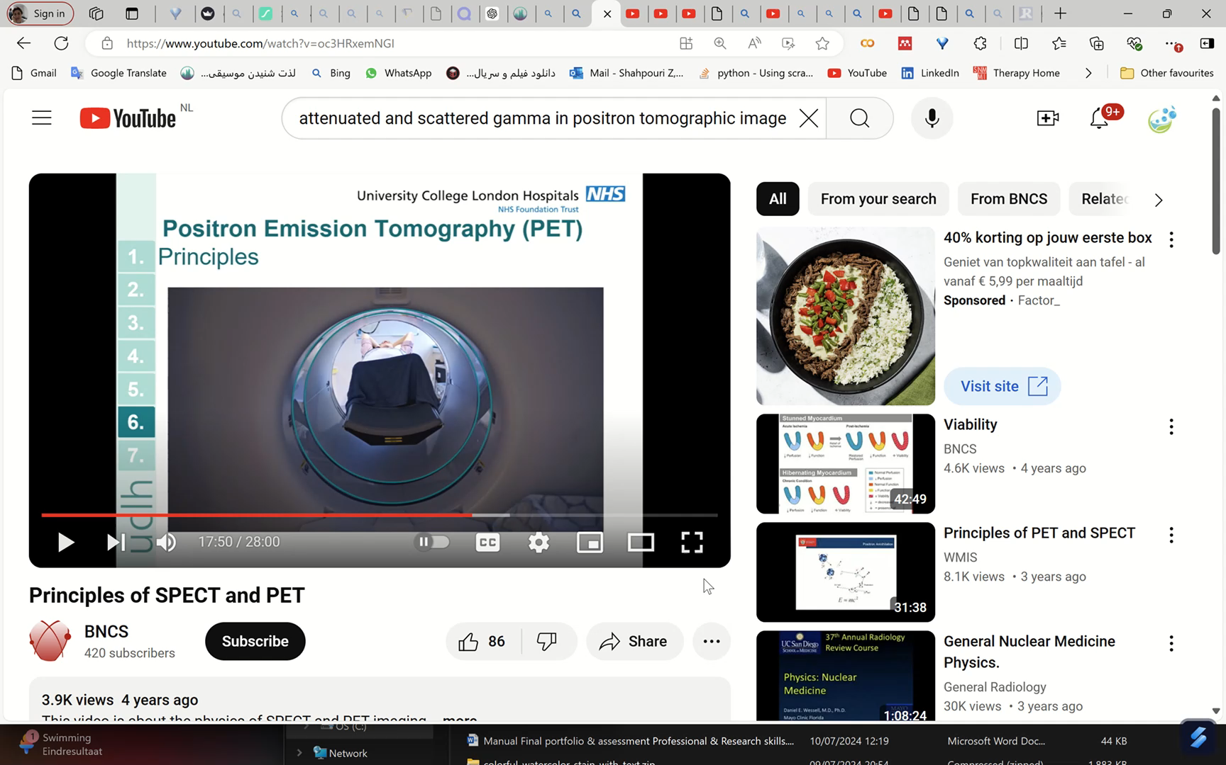
https://youtu.be/oc3HRxemNGI?si=djrXXO1kcawsbd8_

Slide 4
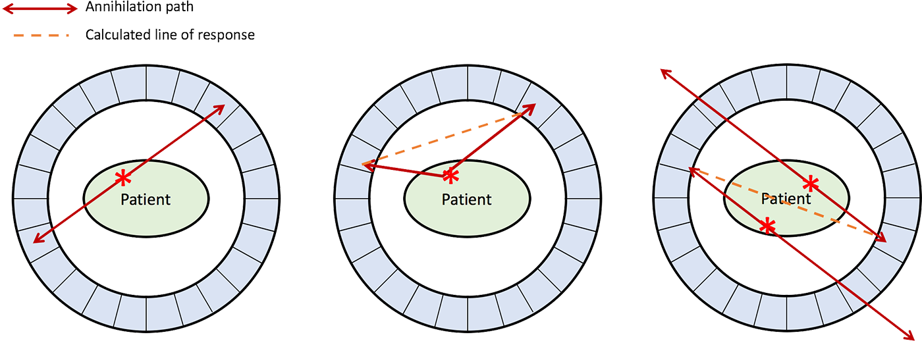
PET Attenuation and Scatter Correction (ASC)
Attenuation correction (AC) of annihilation photons along lines of response (LOR) in the patient body is another critical step
Scatter correction (SC) of Compton scattered photons, which can result in mis-allocation of the annihilated photons, is crucial
True Coincidence
One annihilation
Straight path photons
Scatter Coincidence
One annihilation
Photons scatter
Artifactual measured LOR
Random Coincidence
More than one annihilation
Photons from different annihilations are detected simultaneously
Artifactual measured LOR
https://www.radiologycafe.com/frcr-physics-notes/molecular-imaging/pet-imaging/

Slide 5
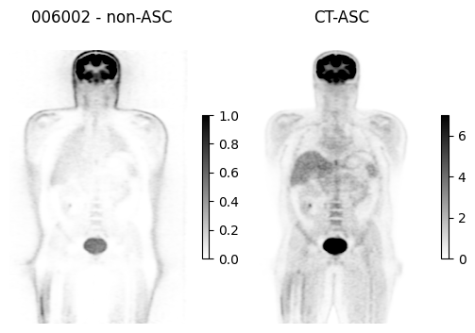
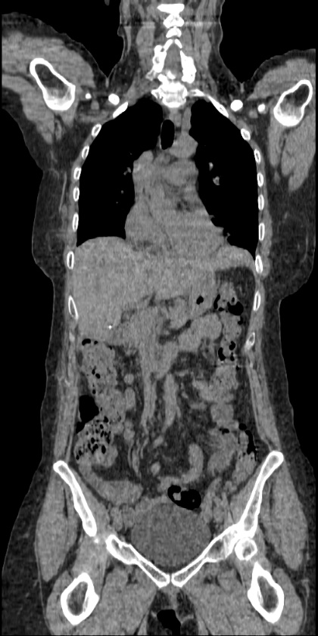
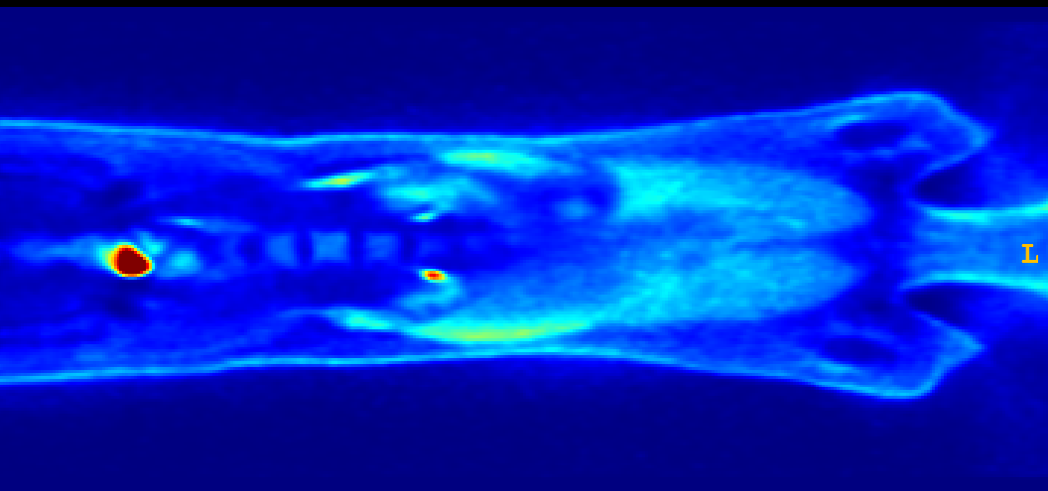
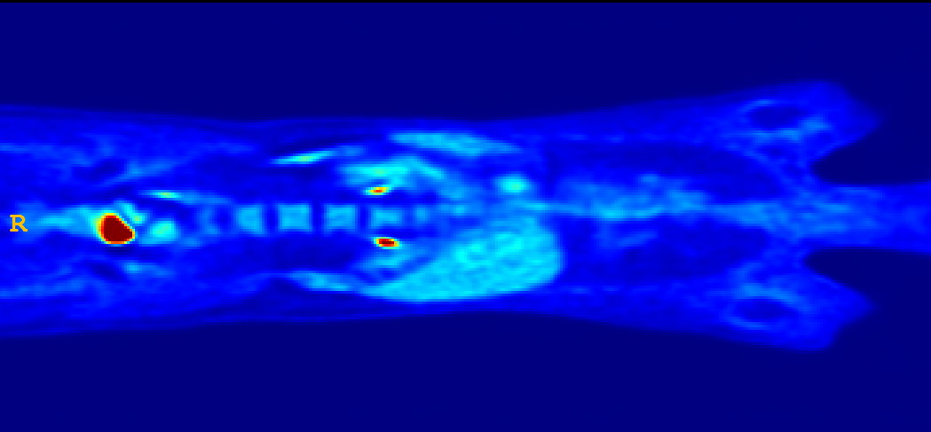
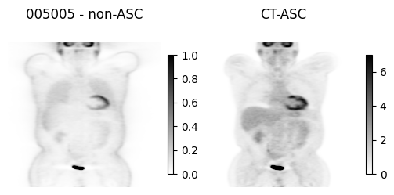
Effects of Attenuation Scatter Correction
reduced mediastinal
uptake
'hot' lungs
Non-uniform liver
Enhanced skin uptake
The non-attenuation corrected image (NAC) PET: with ASC (accurate) CT image (accur

Slide 6
CT Image
X-ray acquisition
Anatomical (CT) Reconstruction
Smooth to PET Resolution
Translate CT to PET Energy (511 keV)
PET Image
PET Emission Acquisition
Attenuation/Scatter Correct PET Emission Data
Functional (PET) Reconstruction
Data flow in a PET/CT scanner
Schmitz et al. The physics of PET/Ct scanners. PET and PET/CT: a clinical guide, 2005.

Slide 7
Challenges in ASC using CT info
☢️Radiation Exposure
⚠️CT Artifacts Impact PET Data
🔄Misalignment Issues
🛠️Metal Artifacts
🌬️Respiratory Pattern Differences
🚫Limited Availability
💰Cost and Complexity
💉Contrast Agent Issues
✂️CT Truncation Effects
🔦CT Bias Due to Beam-Hardening

Slide 8
⁶⁸Ga-labelled pharmaceuticals present challenges due to low tracer activity and extensive positron range.

Slide 9
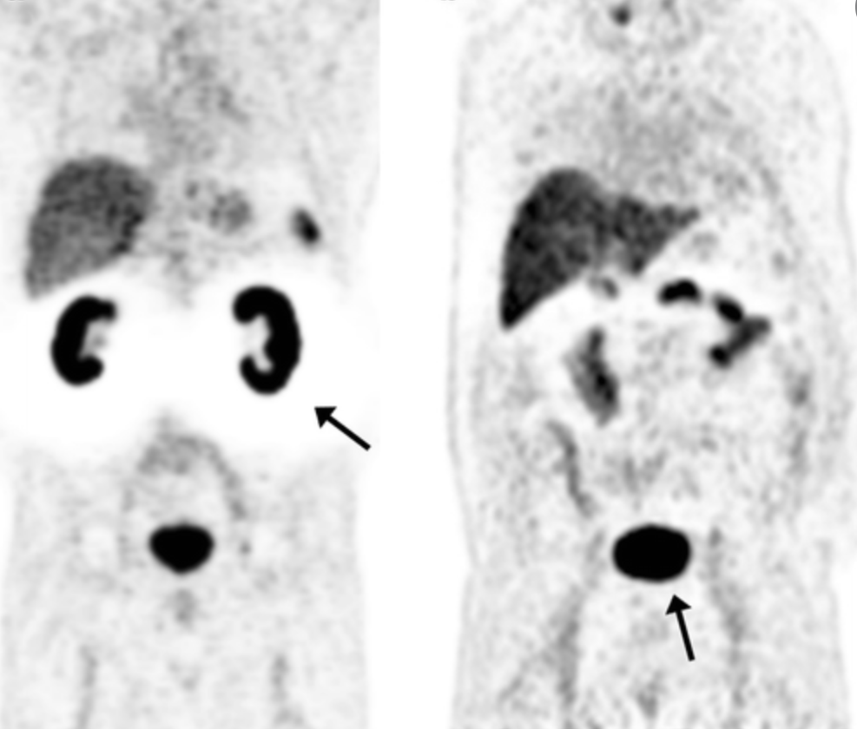
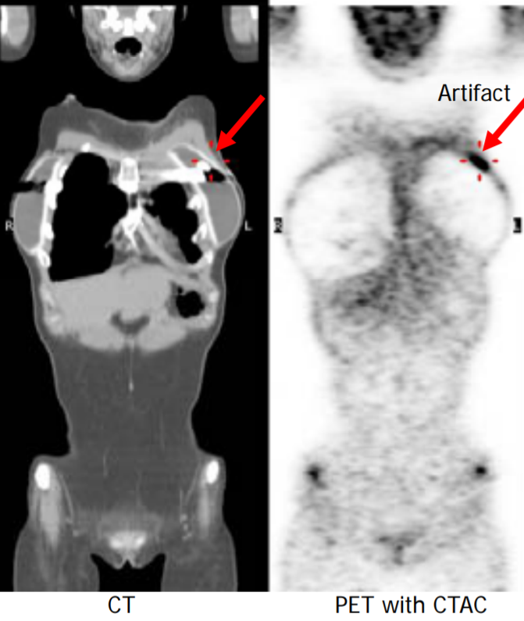
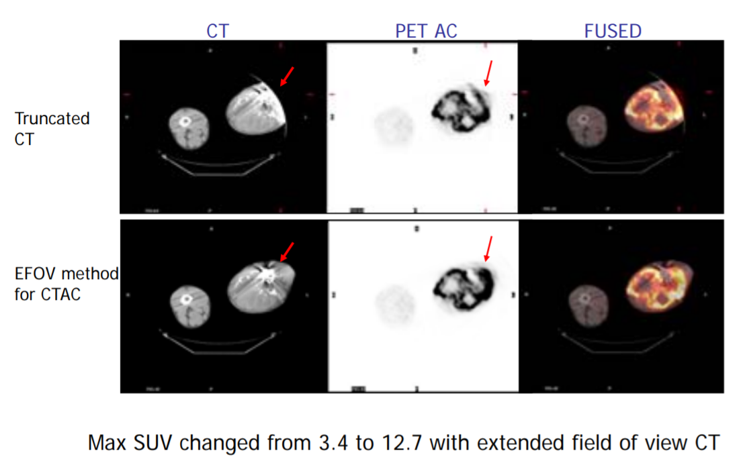
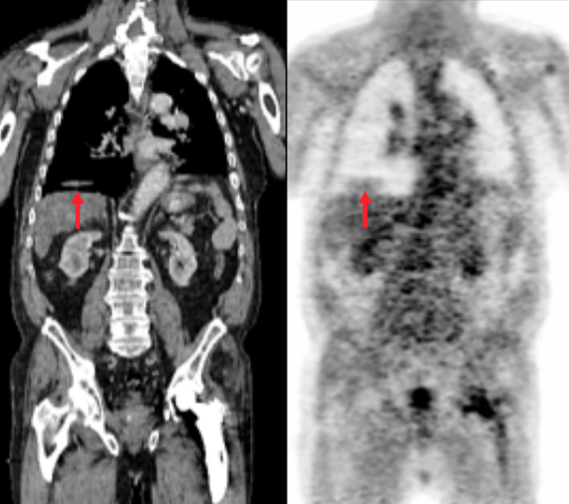
Hallo Artifacts
Metallic
Artifact
Types of common Artifacts
Truncation Artifacts
Motion Artifacts

Slide 10
AI-based ASC in PET
Indirect approaches use MRI or CT to generate attenuation maps.
GANs have been used to create pseudo-CT images from NAC PET scans.
DL-enhanced MLAA algorithm reduces common issues like crosstalk artifacts and noisy attenuation maps.
Direct DL-ASC methods generate ASC PET images directly from NAC images.

Slide 11
⇓Research Objective
✔️ Address direct ASC of PET images without CT anatomical data
✔️ Create a universal model applicable to different radiotracers and scanners ✔️ Evaluate model performance in artifact removal across a multi-center dataset

Slide 12
Materials and Methods

Slide 13
Workflow of A CT-less deep convolutional neural network
PET raw data
Recon = reconstruction;
AC = attenuation correction,
SC = scatter correction,
NAC = noncorrected PET,
MAC = CT-Measured attenuation/scatter corrected,
DL PET = deep learning–corrected PET,
CT images
Recon without AC & SC
Recon with AC & SC
NAC (Input)
MAC (Target)
Model Training
DL PET

Slide 14
Workflow of Decomposition-Based Approach [1]
PET raw data
CT images
Recon without AC & SC
Recon with AC & SC
NAC (Input)
MAC (Target)
Model Training
DL PET
[2] Guo R, Xue S, Hu J, Sari H, Mingels C, Zeimpekis K, et al. Using domain knowledge for robust and generalizable deep
learning-based CT-free PET attenuation and scatter correction. Nat Commun. 2022 Dec 1;13(1).

Slide 15
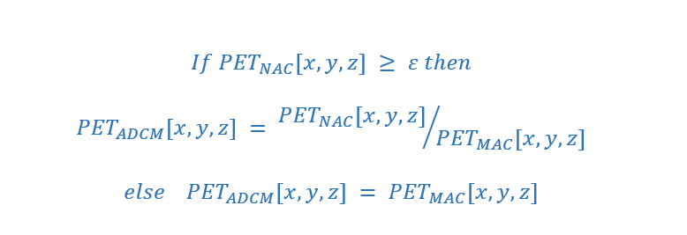
Workflow of Decomposition-Based Approach [1]
NAC (Input)
MAC (Target)
Anatomy-Dependent Correction Maps (ADCM)
Model Training
Anatomy-independent textures
DL PET
[2] Guo R, Xue S, Hu J, Sari H, Mingels C, Zeimpekis K, et al. Using domain knowledge for robust and generalizable deep
learning-based CT-free PET attenuation and scatter correction. Nat Commun. 2022 Dec 1;13(1).

Slide 16
Workflow of Decomposition-Based Approach [1]
NAC (Input)
ADCM
Anatomy-Dependent Correction Maps (ADCM)
Model Training
Anatomy-independent textures
DL PET
[2] Guo R, Xue S, Hu J, Sari H, Mingels C, Zeimpekis K, et al. Using domain knowledge for robust and generalizable deep
learning-based CT-free PET attenuation and scatter correction. Nat Commun. 2022 Dec 1;13(1).

Slide 17
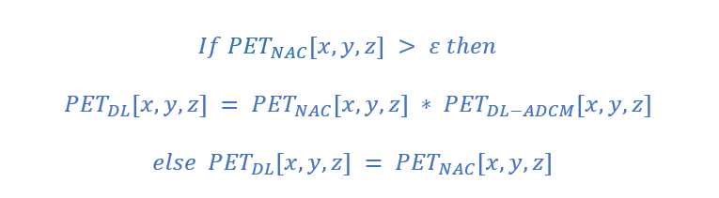
Workflow of Decomposition-Based Approach [1]
NAC (Input)
ADCM
Model Training
DL ADCM
DL PET
[2] Guo R, Xue S, Hu J, Sari H, Mingels C, Zeimpekis K, et al. Using domain knowledge for robust and generalizable deep
learning-based CT-free PET attenuation and scatter correction. Nat Commun. 2022 Dec 1;13(1).

Slide 18
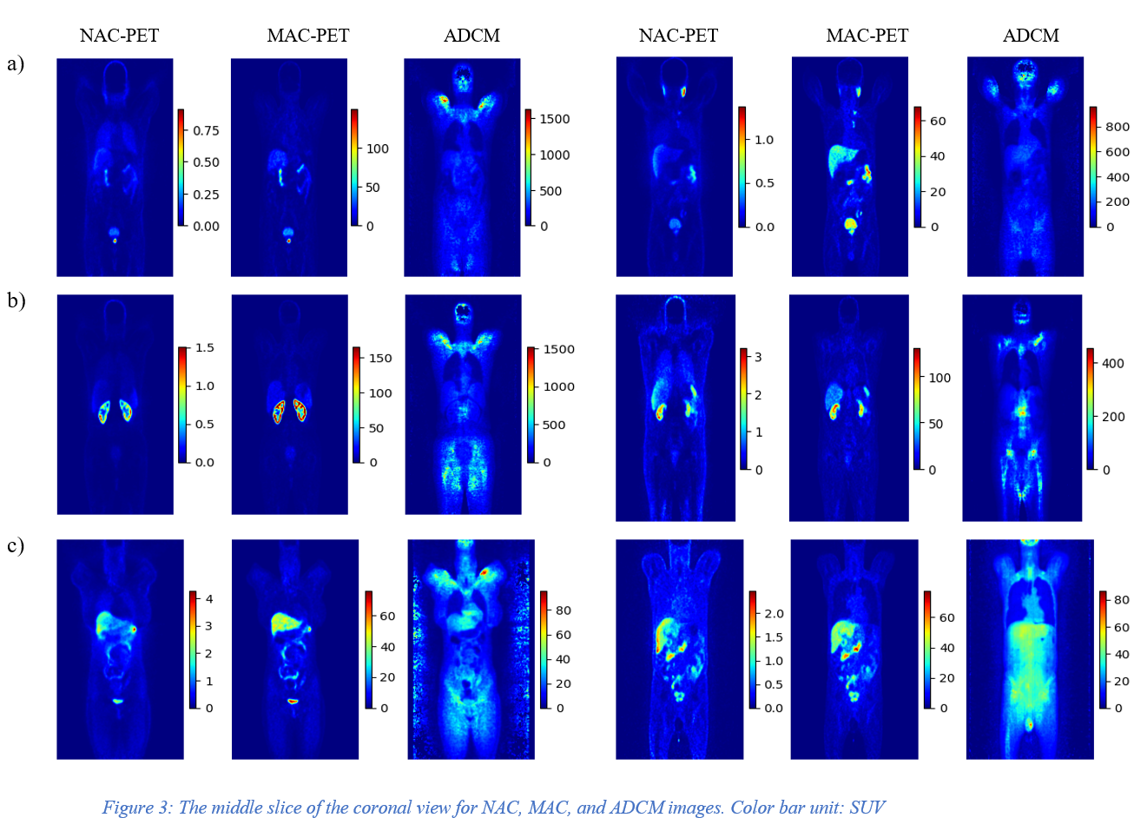

Slide 19
Center | No | Train | Validation | Test | Scanner | Reconstruction | Matrix size × Z*
Center 1 | 56 | 43 | 11 | 2 | Siemens Biograph 6 | 3D-OSEM | 168 × 168
Center 2 | 31 | 25 | 4 | 2 | GE Discovery IQ | 3D-OSEM | 192 × 192
Center 3 | 45 | 35 | 8 | 2 | Siemens mCT | 3D-OSEM | 200 × 200
Center 4 | 40 | 28 | 10 | 2 | Siemens Biograph 6 | 3D-OSEM | 168 × 168
External Center | 12 | - | - | 12 | Siemens Horizon | PSF+TOF+3D-OSEM | 180 × 180
Total | 184 | 131 | 33 | 20 | - | - | -
⁶⁸Ga PET/CT Dataset
Shiri I, Salimi Y, Hervier E, Pezzoni A, Sanaat A, Mostafaei S, et al. Artificial Intelligence-Driven Single-Shot PET Image Artifact Detection and Disentanglement: Toward Routine Clinical Image Quality Assurance. Clin Nucl Med. 2023 Dec 1;48(12):1035–46

Slide 20
18F-FDG Dataset
Center | No | Train | Validation | Test | Scanner | Reconstruction | Matrix size × Z*
Center 6 | 55 | 39 | 6 | 11 | Siemens Biograph 6 | 3D-OSEM | 168 × 168
Center 7 | 43 | 23 | 9 | 10 | GE Discovery IQ | 3D-OSEM | 192 × 192
Total | 98 | 62 | 15 | 21 | - | - | -

Slide 21
198 patients ¹⁸Ga PSMA PET/CT Motion and Halo artifacts
Artifact dataset

Slide 22
Test Sets
Internal Center: 10% of 4 centers of Ga dataset
External Center: one of the 5 centers of Ga dataset
External Tracer (FDG): 10% of 2 centers FDG dataset
Artifact images: All of the dataset

Slide 23
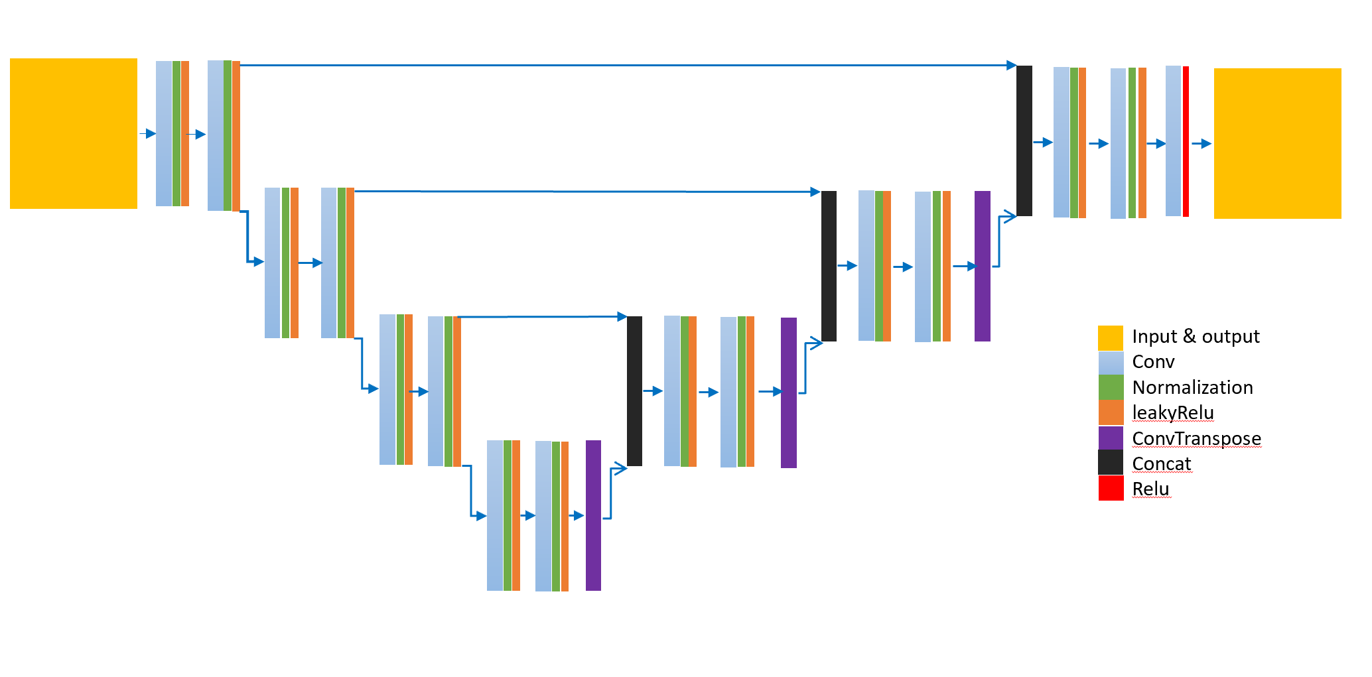
Hyper parameters
Dyn-UNet architecture
3D patches sized 168×168×16
20 patches per patient
Loss function of the mean squared error (MSE)
Learning rate of 0.001
Optimization Adam algorithm
Batch size: 4
spacing : [4.07, 4.07, 3.00]
four layers: [16, 32, 64, 128]
Kernels: [3, 3, 3]
2 super vision head
The architecture of DynUnet

Slide 24
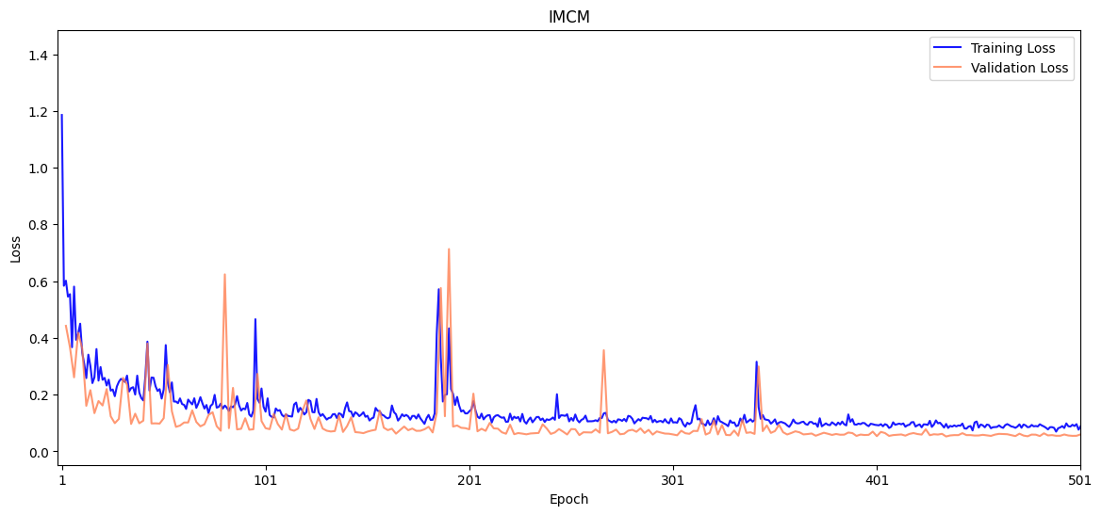
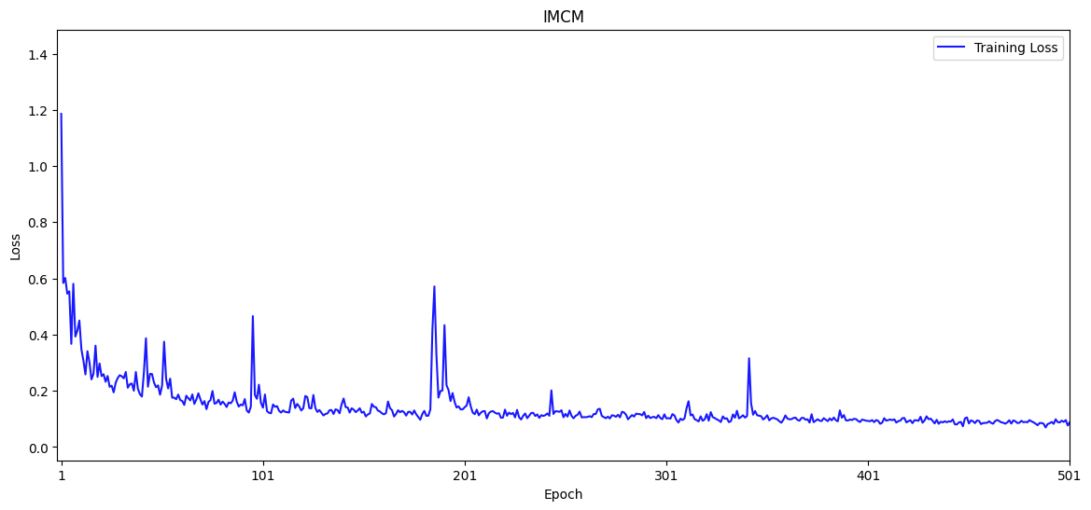
¹⁸F-FDG
Integrated multi-Centre model (IMCM): the best metric of 0.0527 at epoch 434.

Slide 25
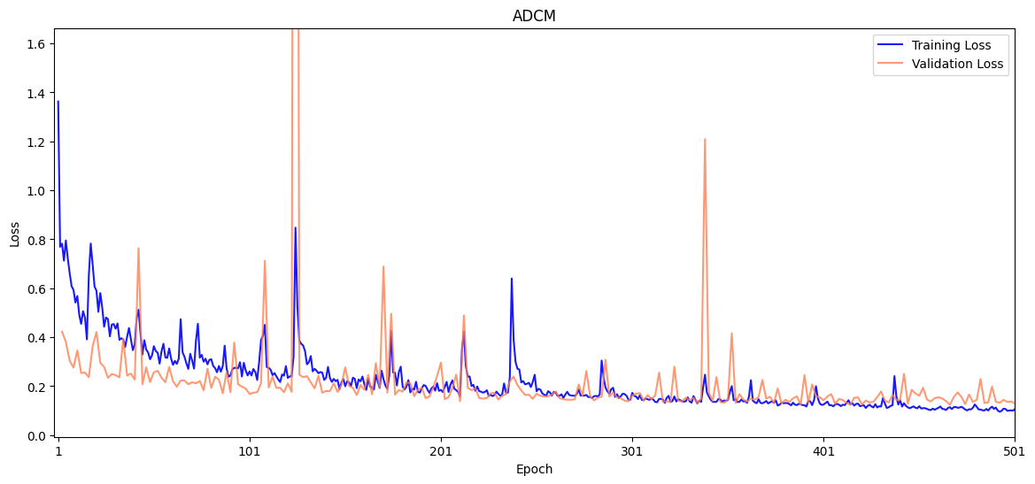
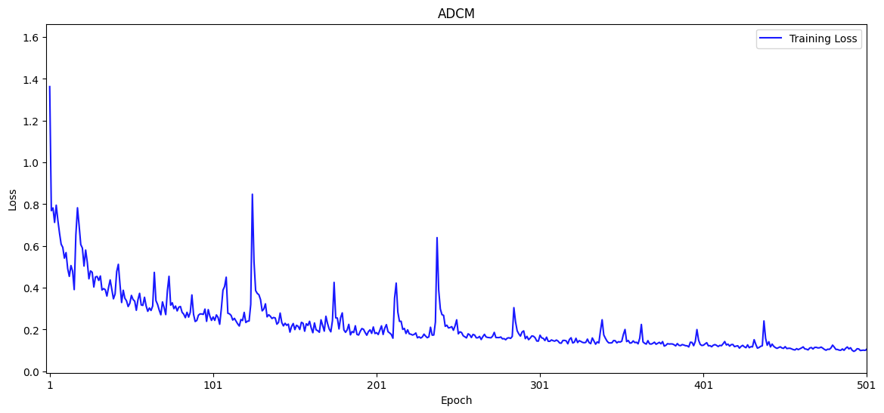
⁶⁸Ga-PET
Anatomy-Dependent Correction Model (ADCM): the best metric of 0.1237 was reached at epoch 466.

Slide 26
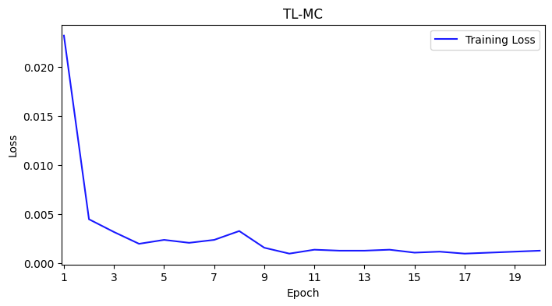
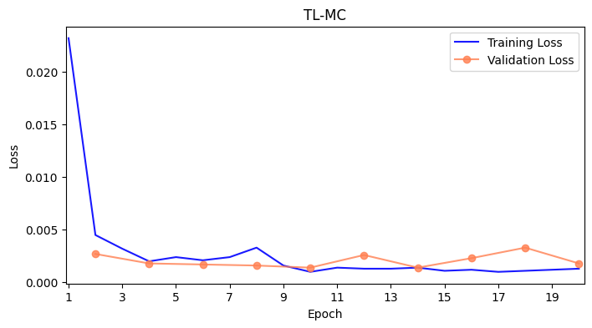
¹⁸F-FDG
Transfer Learning for IMCM model (TL-MC):

Slide 27
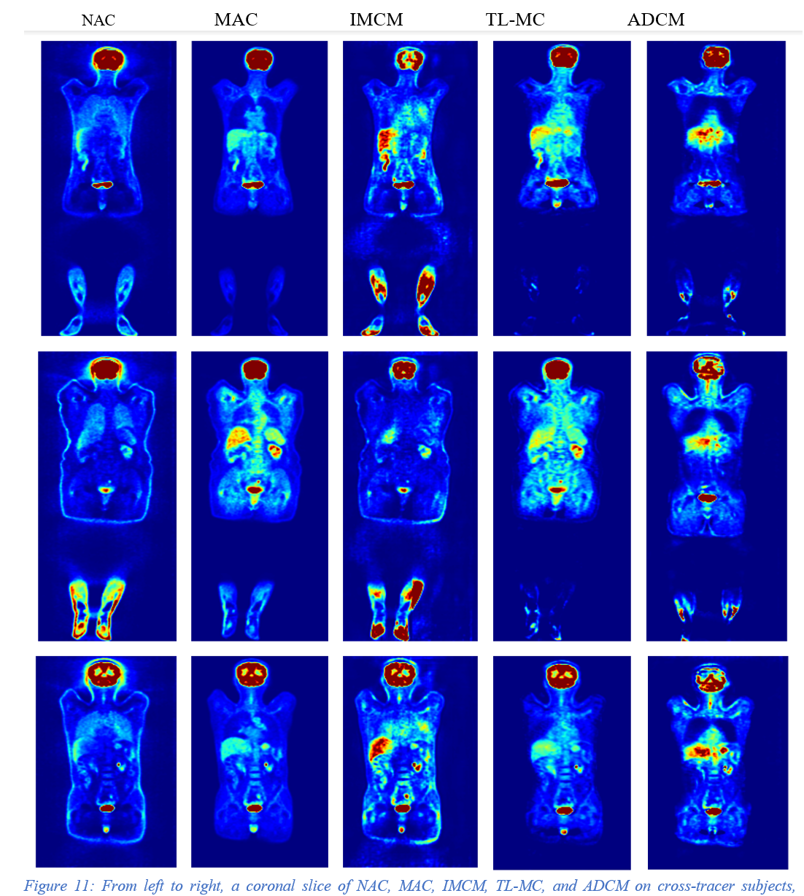
¹⁸F-FDG

Slide 28
Results

Slide 29
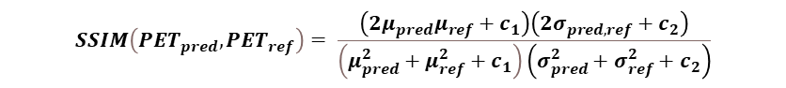
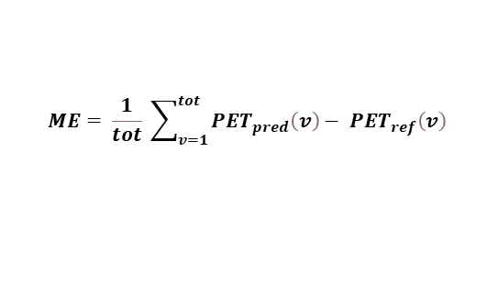
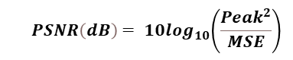
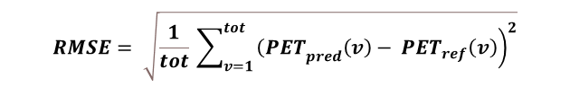
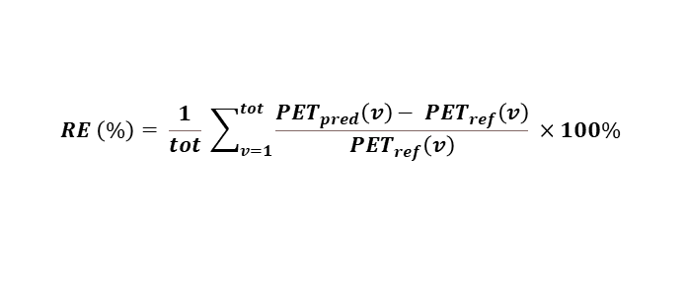
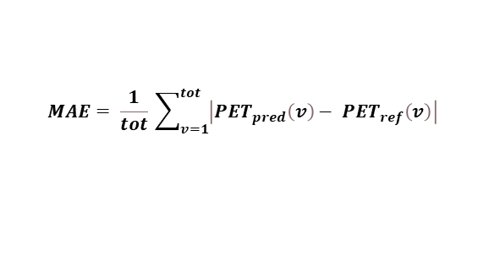
Cross-Center
$$ME= \frac{1}{tot} \sum_{v=1}^{tot}{{PET}_{pred}\left(v\right)− {PET}_{ref}\left(v\right) }$$
$$MAE= \frac{1}{tot} \sum_{v=1}^{tot}{\left|{PET}_{pred}\left(v\right)− {PET}_{ref}\left(v\right)\right| }$$
$$RE \left(\%\right)= \frac{1}{tot} \sum_{v=1}^{tot}{\frac{{PET}_{pred}\left(v\right)− {PET}_{ref}\left(v\right)}{{PET}_{ref}\left(v\right)} ×100\% }$$
$$RMSE= \sqrt{\frac{1}{tot} \sum_{v=1}^{tot}{{\left.{\left(PET\right.}_{pred}\left(v\right)− {PET}_{ref}\left(v\right)\right)}^{2}}}$$
$${ PSNR\left(dB\right)= 10log}_{10}\left(\frac{{Peak}^{2}}{MSE}\right)$$
⁶⁸Ga-PET
$$SSIM\left({PET}_{pred},{PET}_{ref}\right)= \frac{\left(2μ_{pred}μ_{ref}+c_{1}\right)\left(2σ_{pred,ref}+c_{2}\right)}{\left(μ_{pred}^{2}+μ_{ref}^{2}+c_{1}\right)\left(σ_{pred}^{2}+σ_{ref}^{2}+c_{2}\right)}$$

Slide 30
Cross-Center
⁶⁸Ga-PET

Slide 31
Cross-Tracer
¹⁸F-FDG

Slide 32
Cross-Tracer
¹⁸F-FDG

Slide 33
Case Study on artifact images

Slide 35
Coronal views of 6 clinical studies, representing from left to right: NAC, MAC, IMCM-DL and the difference images of MAC and DL image. Our method effectively disentangles halo artefacts in the kidney area.

Slide 36
Coronal views, showing from left to right NAC, MAC, IMCM-DL and the difference images of MAC and DL image. The images generated using the IMCM approach successfully corrected the mismatch artefact in the diaphragm, lung, liver and spleen regions.

Slide 37
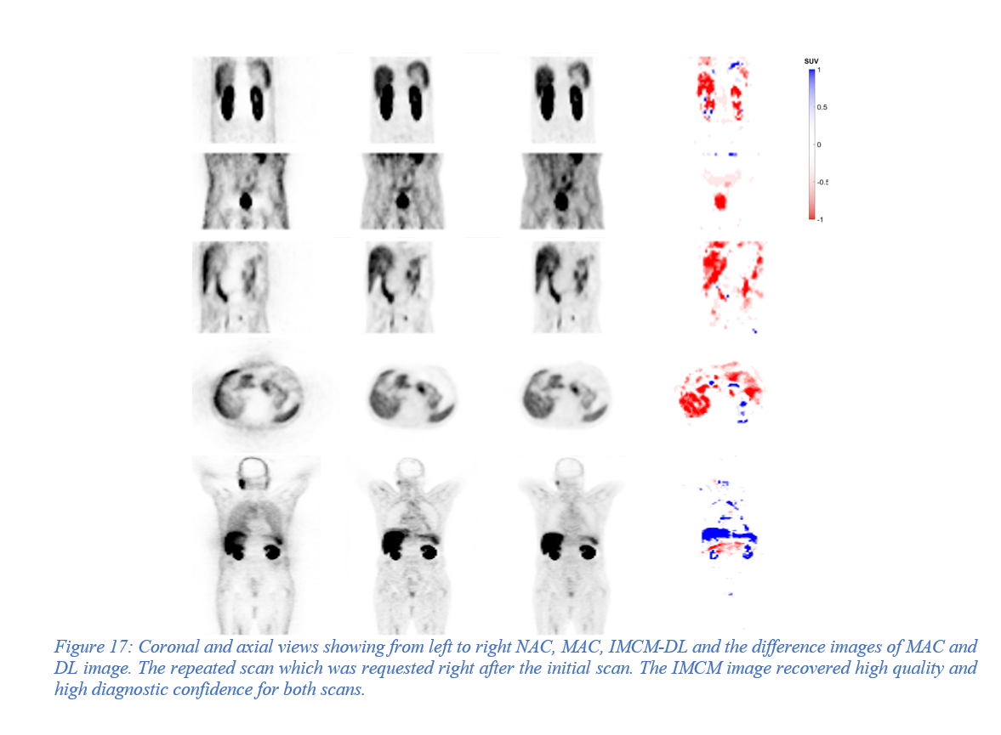

Slide 38
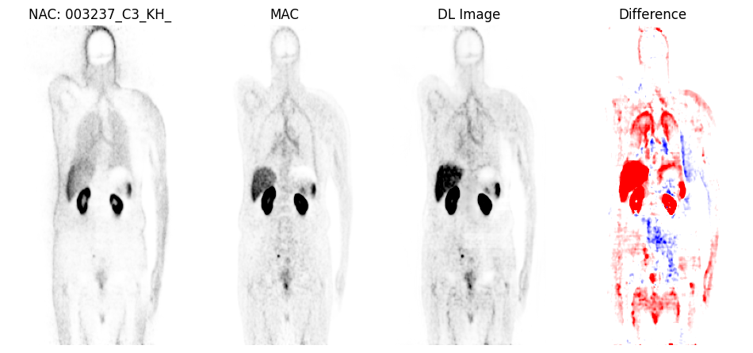
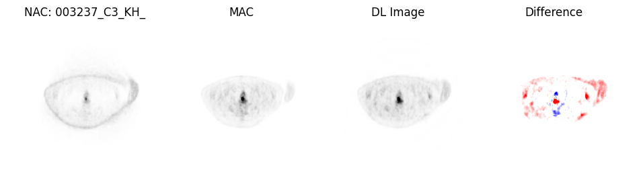

Slide 39
Discussion
Developed CT-free DL models (IMCM and ADCM) for ASC in PET imaging, tested across different centers and radiotracers.
Single universal models may not be effective; radioisotope-specific tuning is necessary.
Using large, heterogeneous datasets enhances ASC accuracy in PET images.
IMCM showed significant improvement in quantitative accuracy and artifact correction.
IMCM outperformed ADCM, demonstrated more reliable and consistent performance in SUV estimations.

Slide 40
Conclusion

Slide 41
DL methods improve both quantitative and qualitative aspects of PET images, detecting and correcting artifacts without anatomical images.
Designing a neural network for applying ASC on PET images without using CT data.
Working well in different centers, making it reliable and flexible for use in clinics.
challenging the model's capability in detecting and removing artifacts in PET scans.
Created special models for each site using transfer learning.

Slide 42
Limitations

Slide 43
Future Work
Future research should focus on clinical imaging parameters and organ-specific evaluations.
Different neural networks and optimizers could improve model performance.
Model performance must be evaluated across various centers for generalization and robustness.
Clinical Imaging Parameters:
Explore SUVmean, SUVmax, and total lesion metabolism.
Assess radiomic features within the sphere of influence.
Organ-Specific Evaluations:
Targeted analysis for clean and artifactual images.
Rigorous statistical testing of categorized outcomes.
Alternative Neural Networks:
Investigate generative adversarial networks (GANs), variational autoencoders, transformer-based models, or Swin-UNet.
Hyperparameter Optimization:
Experiment with optimizers like AdamW, RMSprop, and Nadam.
Use tools like Optuna for systematic hyperparameter tuning.
Multi-Center Evaluation:
Test model performance on data from different centers.
Ensure consistency and reliability across various clinical environments.

Slide 44


